Slide 1

CYBERSECURITY
PROTECTING YOURSELF IN A DIGITAL WORLD
Dave Hatter, CISSP, CISA, CISM, CCSP, CSSLP, PMP, ITIL
Cybersecurity Consultant
Intrust IT
linkedin.com/in/davehatter | x.com/davehatter

Slide 2

Setting the Table

Slide 3
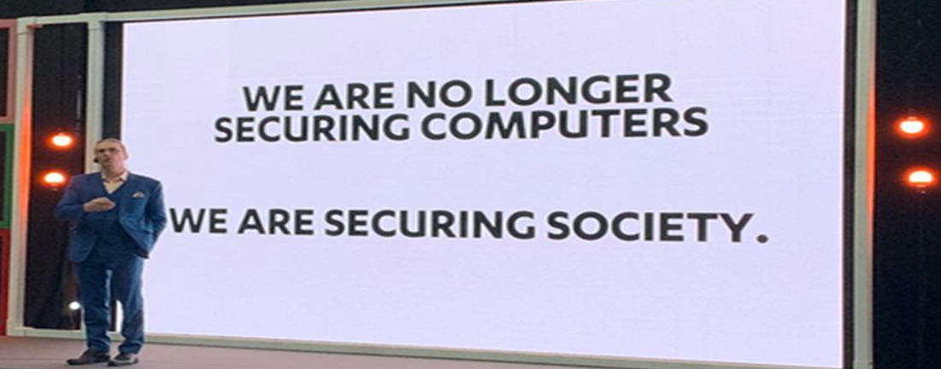
Notes:
Mikko

Slide 4
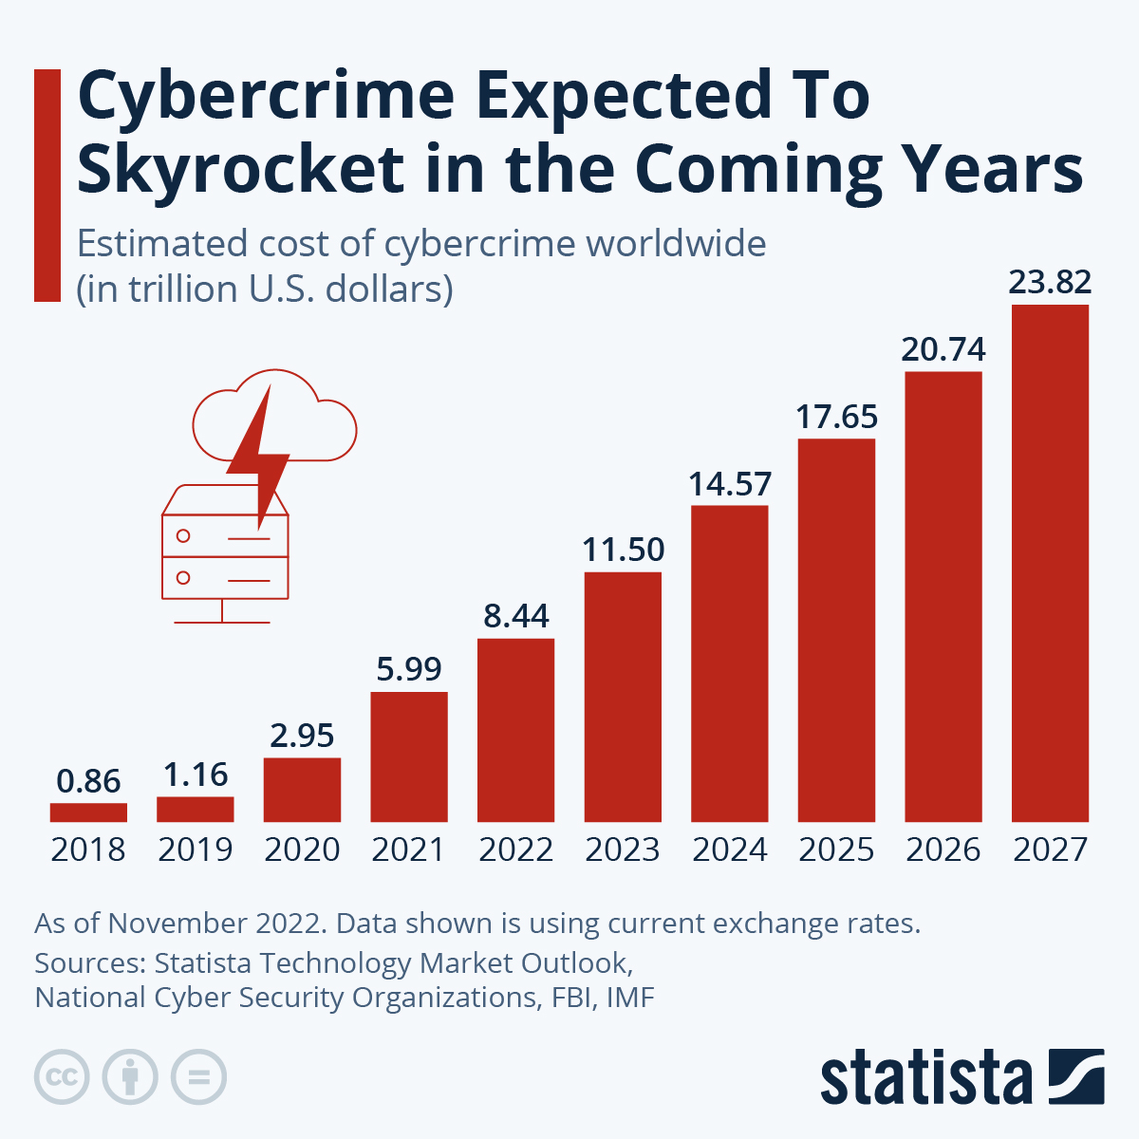

Slide 5
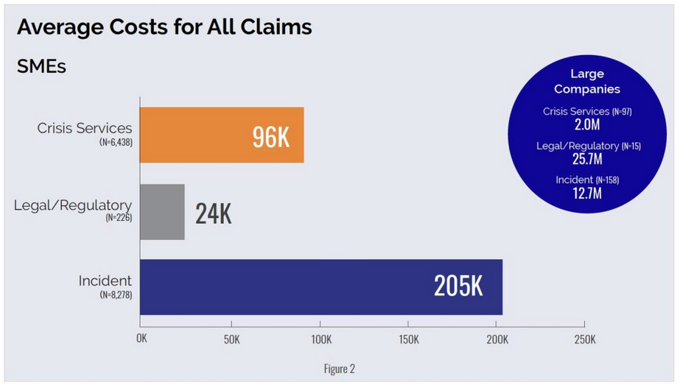
Notes:
https://www.coalitioninc.com/blog/2024-cyber-claims-report
Quick poll

Slide 6
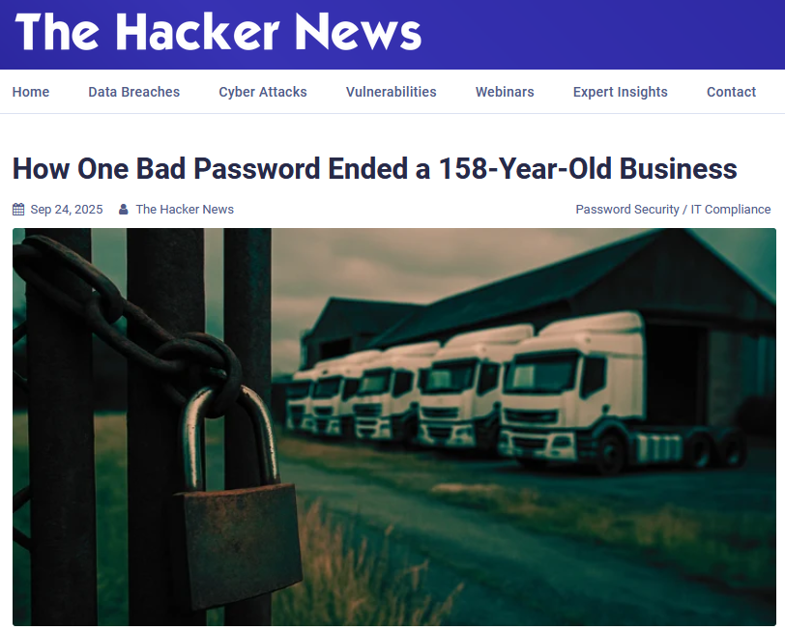
Notes:
The Northamptonshire-based firm fell victim to the Akira ransomware group after hackers gained access by guessing an employee's weak password. Attackers didn't need a sophisticated phishing campaign or a zero-day exploit - all they needed was a password so simple that cybercriminals could guess it correctly.

Slide 7
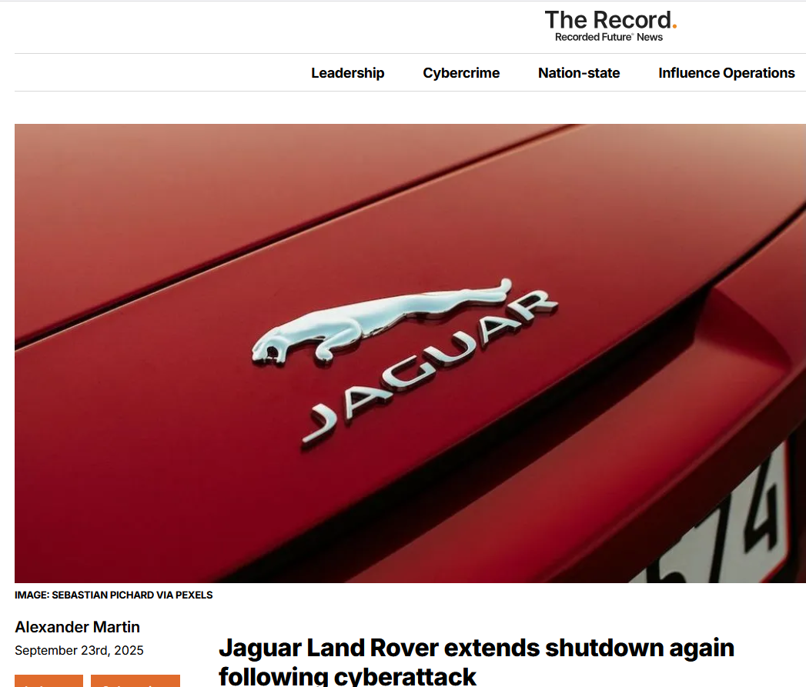
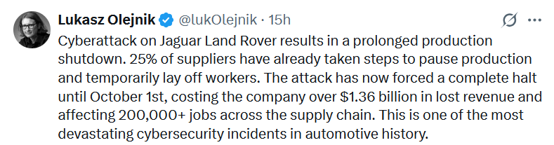
Notes:
Alongside its impact to the company, which is estimated to be losing £50-70 million ($67-94 million) per day, the standstill is having a dramatic impact on JLR’s supply-chain businesses in what one senior politician called “a cyber shockwave ripping through our industrial heartlands.”
More than 30,000 people are directly employed by JLR, while around 150,000 others are believed to be connected to it. Thousands of agency and temporary workers have been let go, while other employees have been told to stay at home on reduced pay.

Slide 8
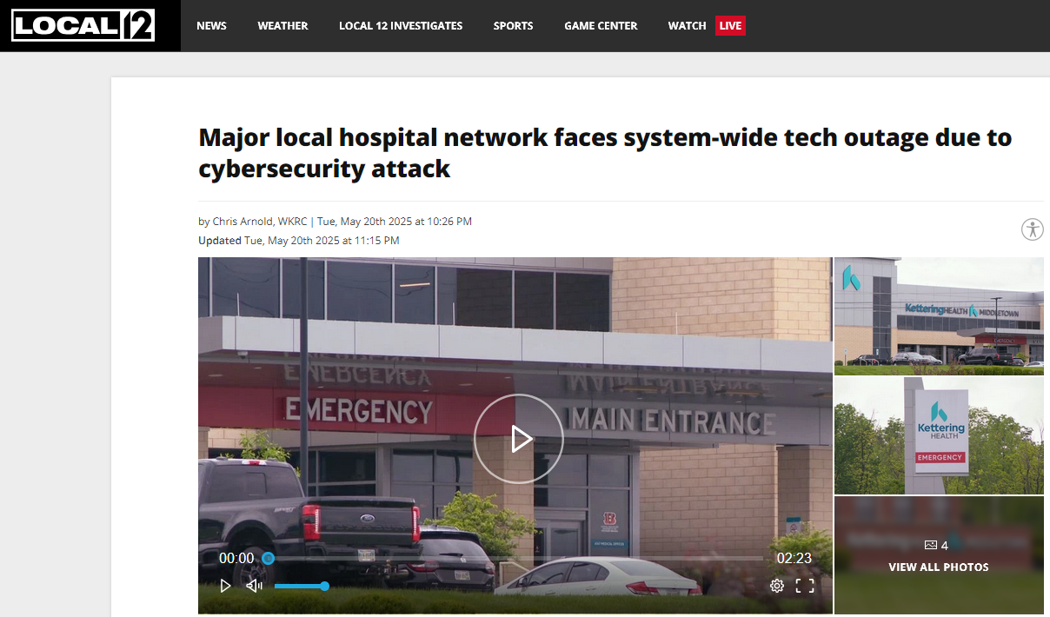
Notes:
https://local12.com/news/local/major-hospital-network-faces-system-wide-tech-outage-due-cybersecurity-attack-hacked-hacking-money-ransom-patients-doctor-intake-care-hospitals-kettering-health-miami-valley-outages-cyber-online-ransomware-cincinnati-ohio#

Slide 9
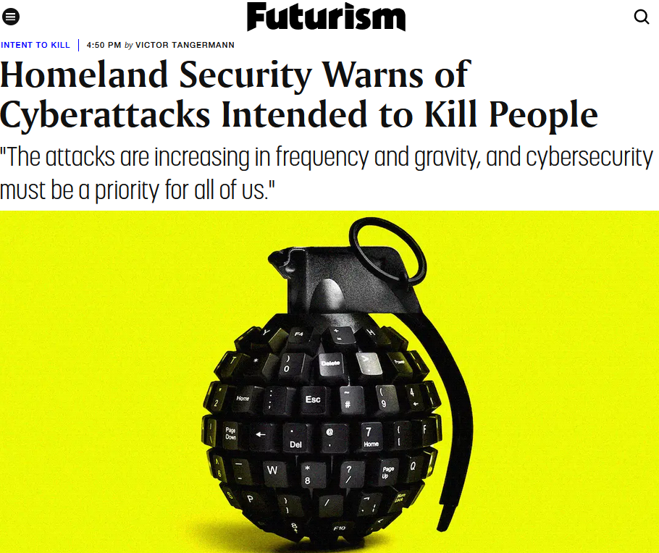
Notes:
Warnings from WH, FBI, DHS
NEXT: WHY NOW?

Slide 10
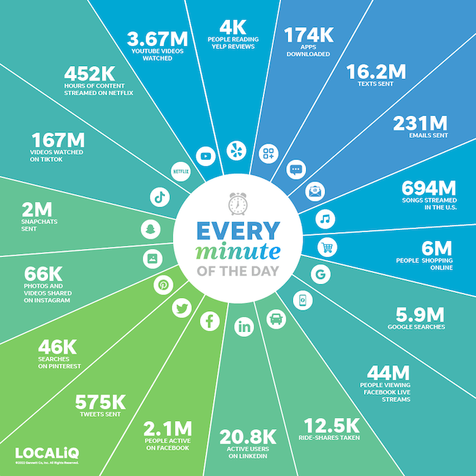
Notes:
“Over 2.5 quintillion bytes of data are created every single day, and it’s only going to grow from there. By 2020, it’s estimated that 1.7MB of data will be created every second for every person on earth.” – Sixth Annual Domo report

Slide 11
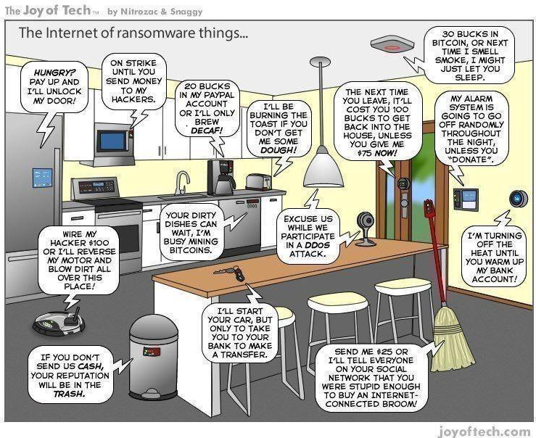
Notes:
Internet of Insecure Things
76 billion by 2025
Often not designed with security in mind
Easily found with Shodan
Vector for network attack
Can be used to spy on you & your organization
Can host malware

Slide 12
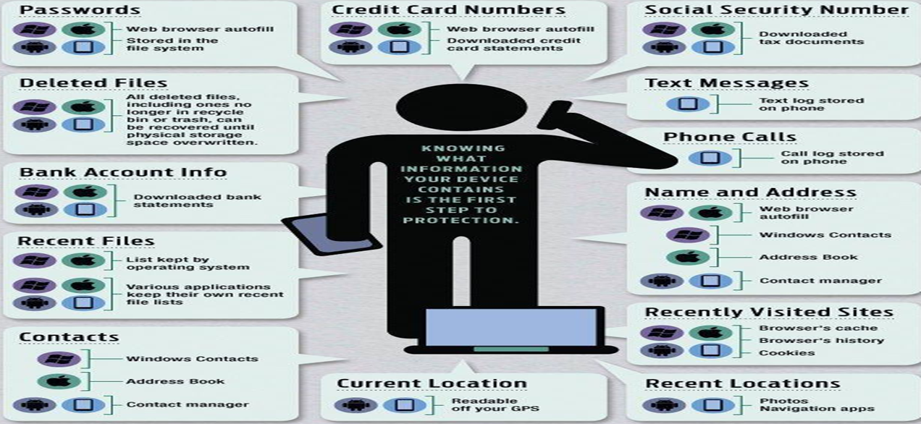
Notes:
Surveillance capitalism
https://www.thecybersecurityhub.com/

Slide 13
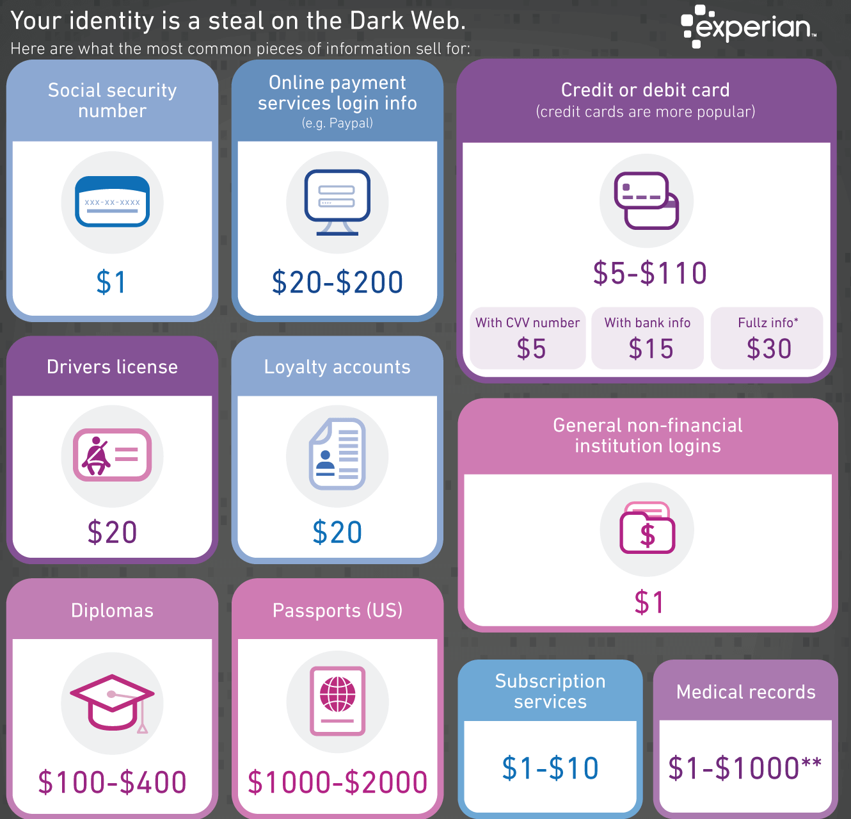

Slide 14
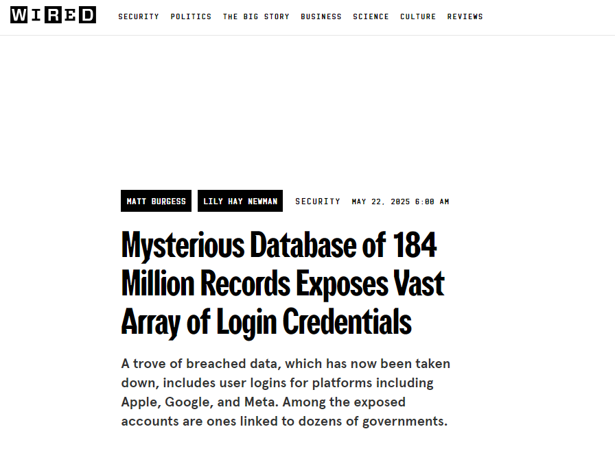
Notes:
https://www.microsoft.com/en-us/security/security-insider/intelligence-reports/microsoft-digital-defense-report-2024

Slide 15
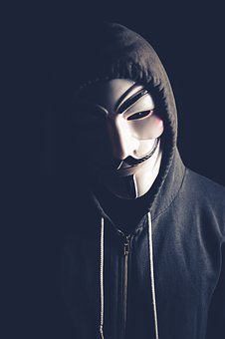
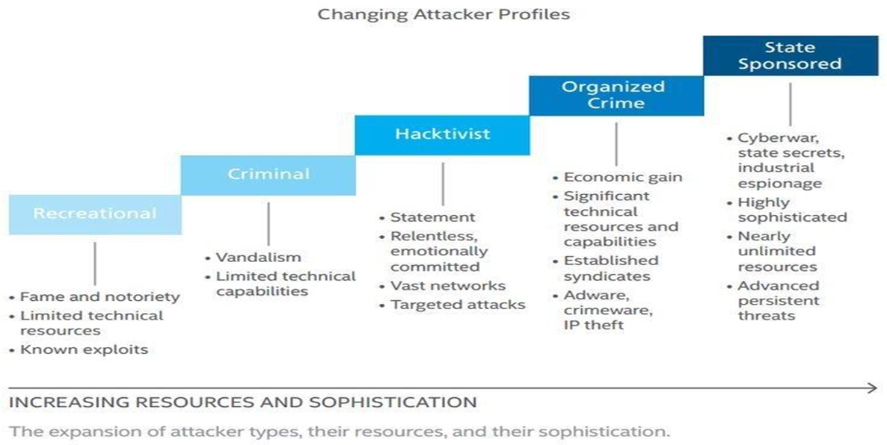
Notes:
Lone Wolf: Paige Thompson –Capital One

Slide 16
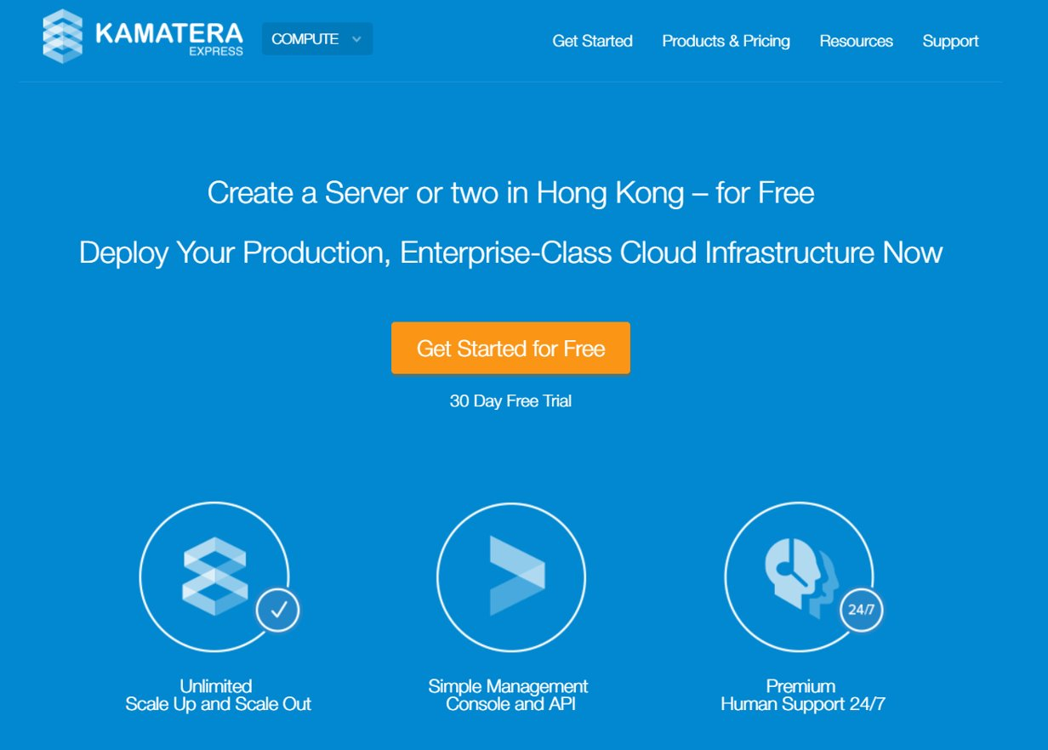
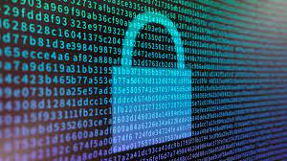


Slide 17
The Human Factor
85%
“Only amateurs attack machines; professionals target people.” – Bruce Schneier
Notes:
2021 Verizon DBIR
NEXT: THREATS

Slide 18
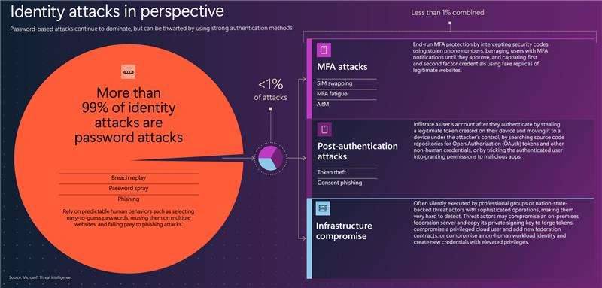
Notes:
https://www.microsoft.com/en-us/security/security-insider/intelligence-reports/microsoft-digital-defense-report-2024

Slide 19
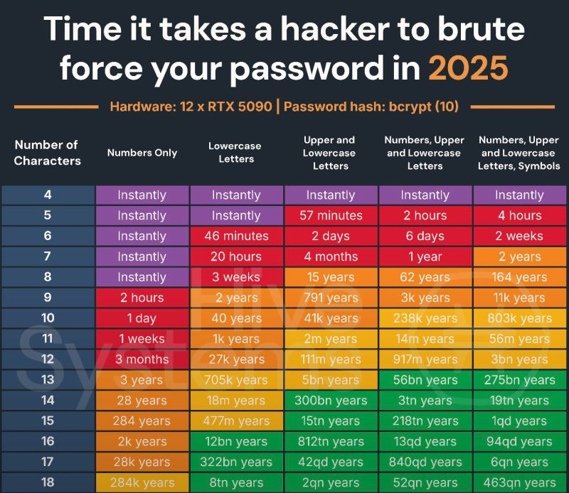
Notes:
Hivesystems.com/password
Hashing Algorithm: It assumes bcrypt with cost factor 10, which is intentionally slow and significantly increases brute-force time. Many systems don’t use bcrypt, and some use faster (weaker) hashes like MD5 or SHA-1, which would be much faster to brute-force.
Hardware: The chart assumes a very powerful setup—12 NVIDIA RTX 5090 GPUs. Most attackers won’t have that, but some state-level or cybercrime groups do.
Real-World Attacks: Brute-force is usually a last resort. Most real-world password breaches come from reused credentials, phishing, malware, or leaks—not brute force.

Slide 20
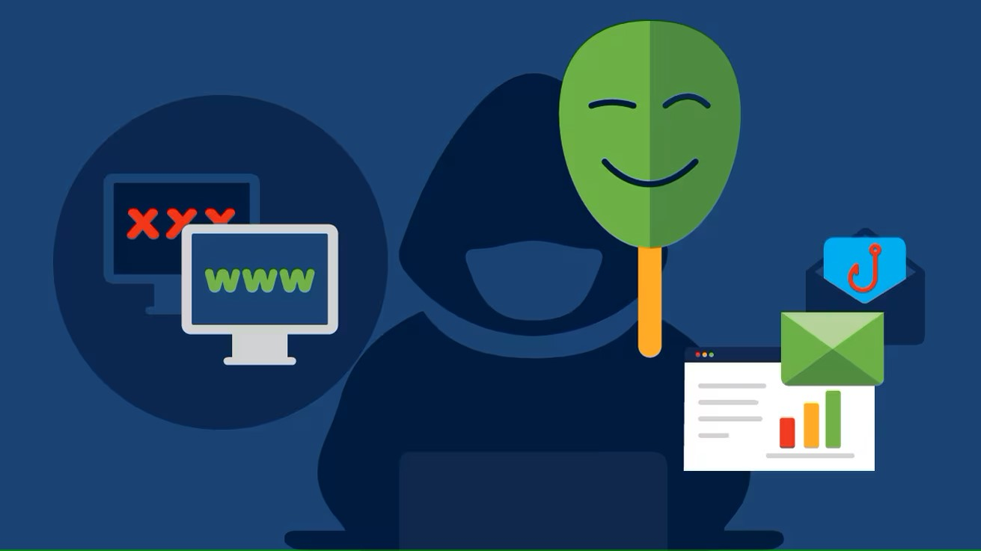
"Spoofing, in general, is a fraudulent or malicious practice in which communication is sent from an unknown source disguised as a source known to the receiver. " – Techopedia

Slide 21
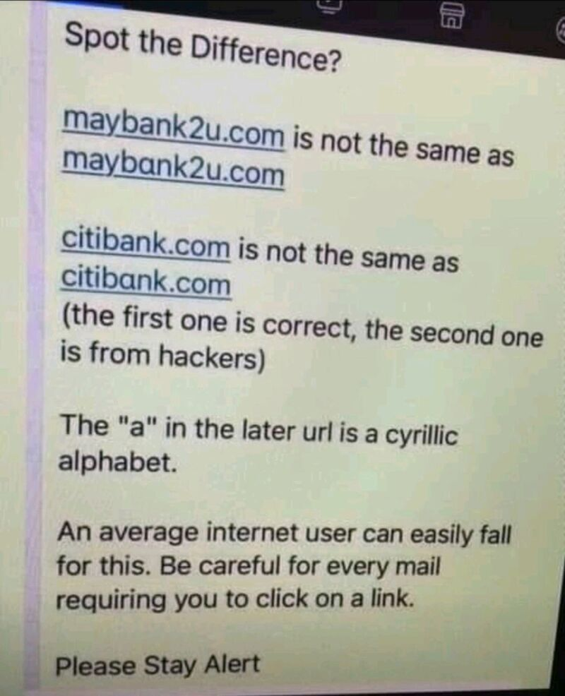
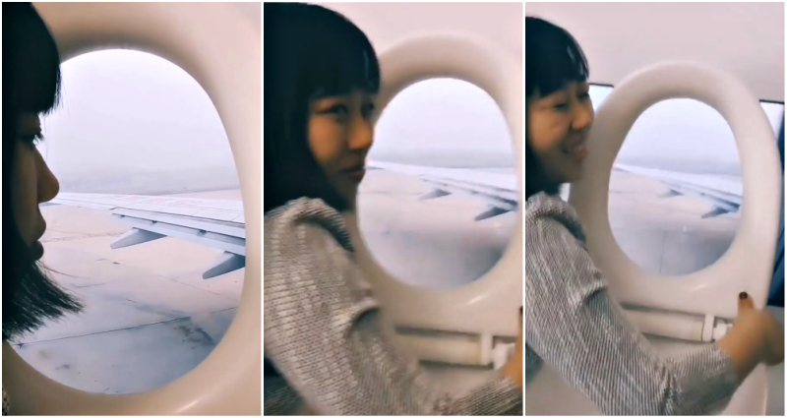

Slide 22
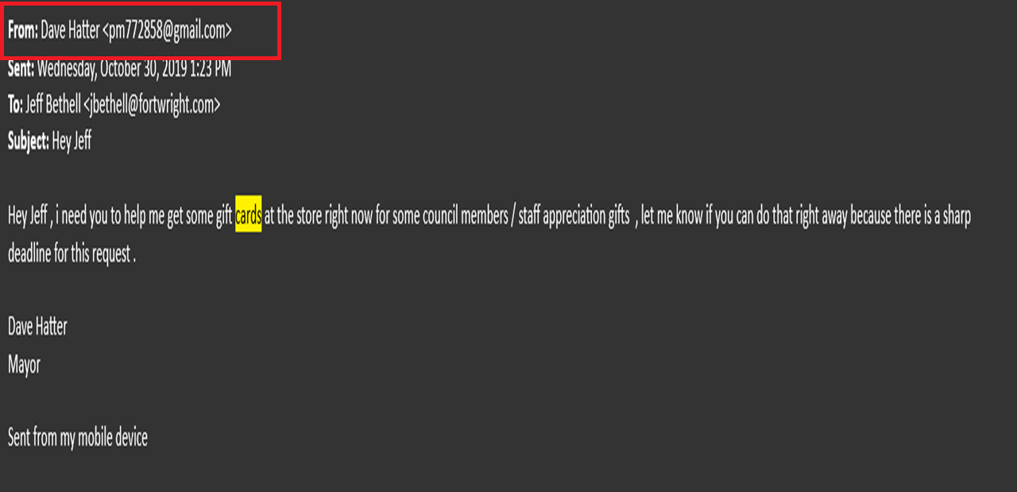

Slide 23
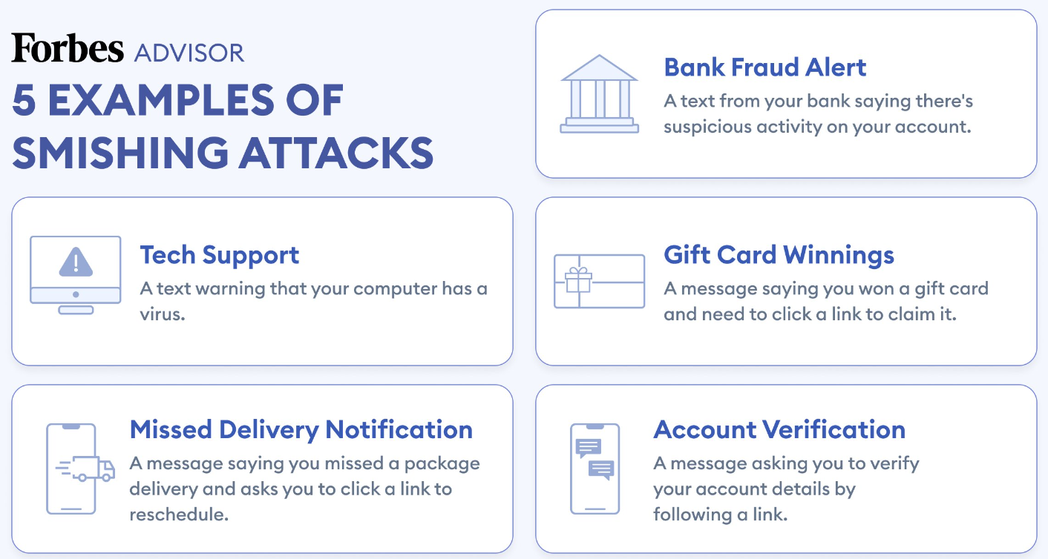

Slide 24
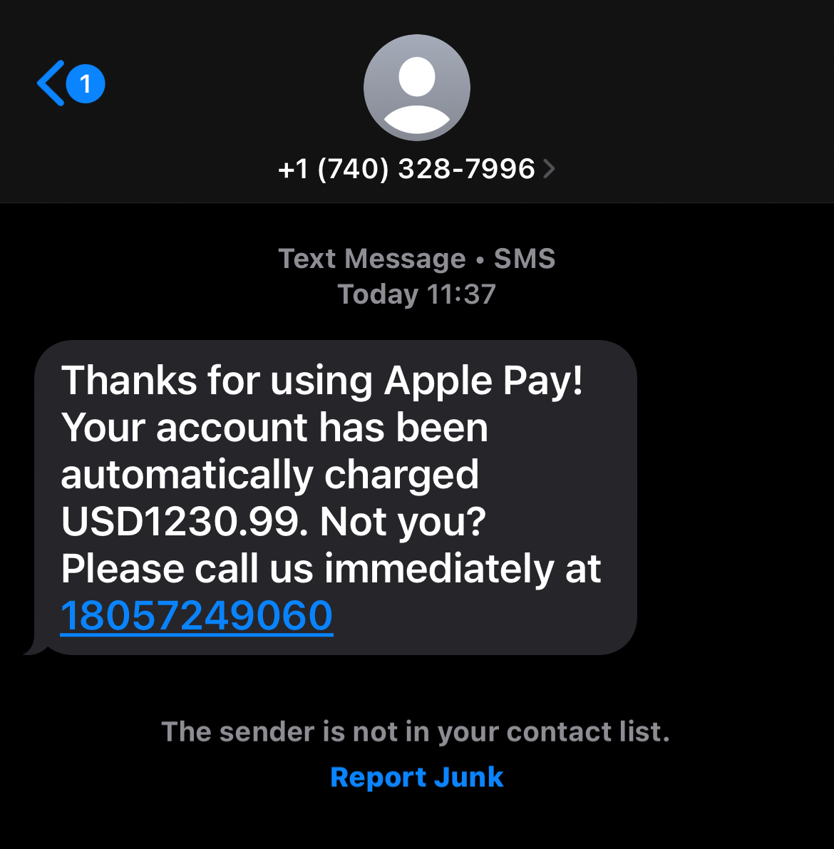

Slide 25
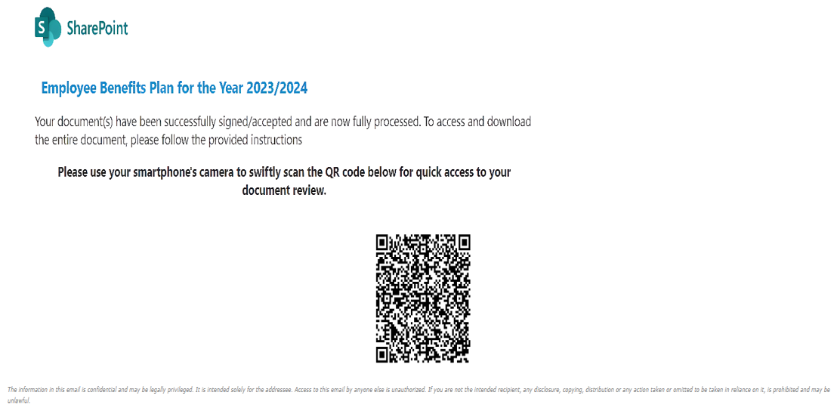
Notes:
https://local12.com/news/consumer-alerts/qr-code-scams-on-the-rise-as-criminals-exploit-technology-cincinnati-fighting-fraud-menus-posters-parking-emails-social-media-dave-hatter#

Slide 26
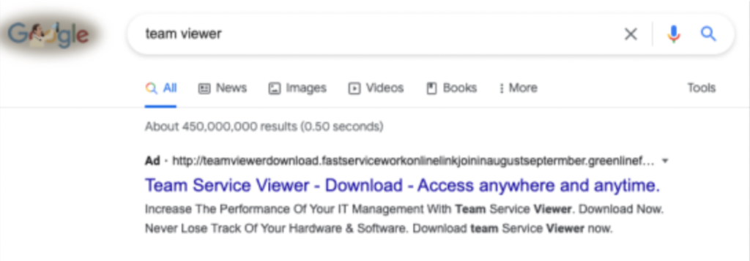
Search Engine Poisoning
Notes:
2021 Verizon DBIR
NEXT: THREATS

Slide 27
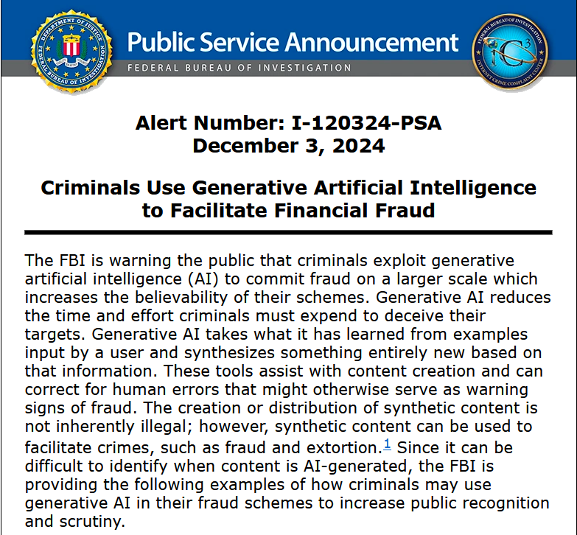
Notes:
https://www.ic3.gov/PSA/2024/PSA241203

Slide 28
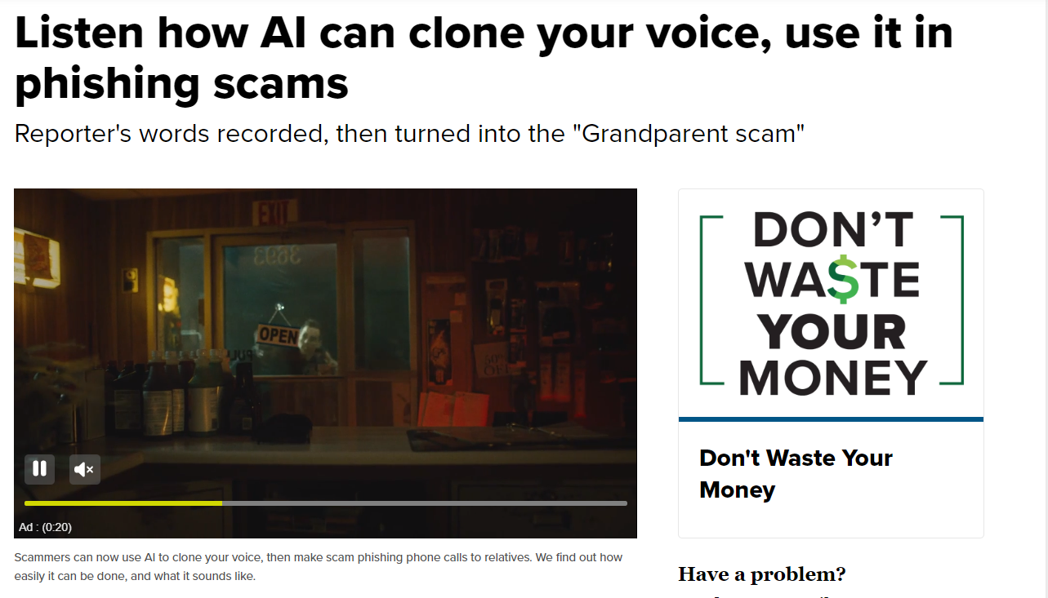
Notes:
https://www.wcpo.com/listen-how-ai-can-clone-your-voice-use-it-in-phishing-scams
https://www.fox19.com/2024/05/28/experts-discuss-dangers-ai/

Slide 29
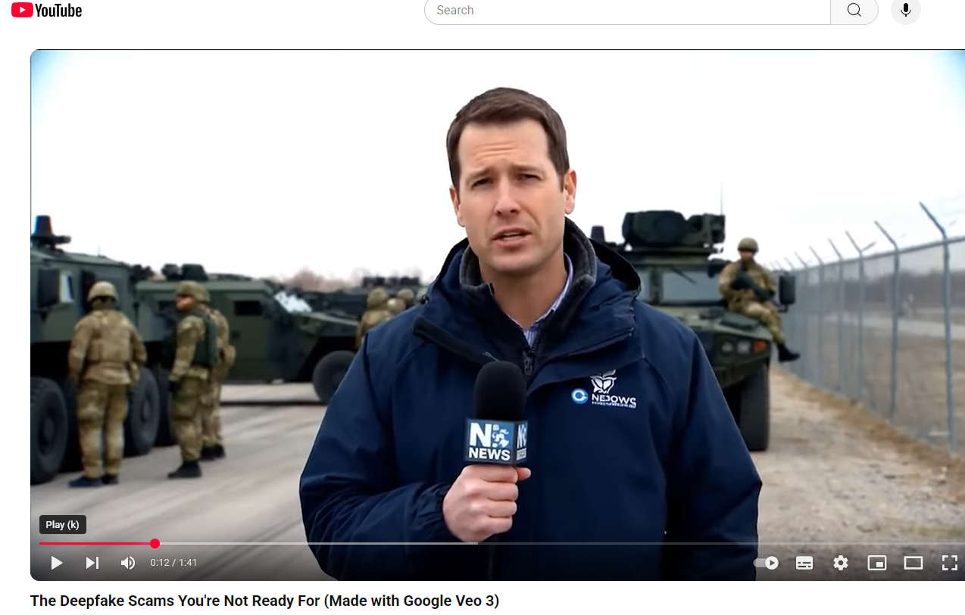
Notes:
https://www.youtube.com/watch?v=xyaSVBXF1K8

Slide 30
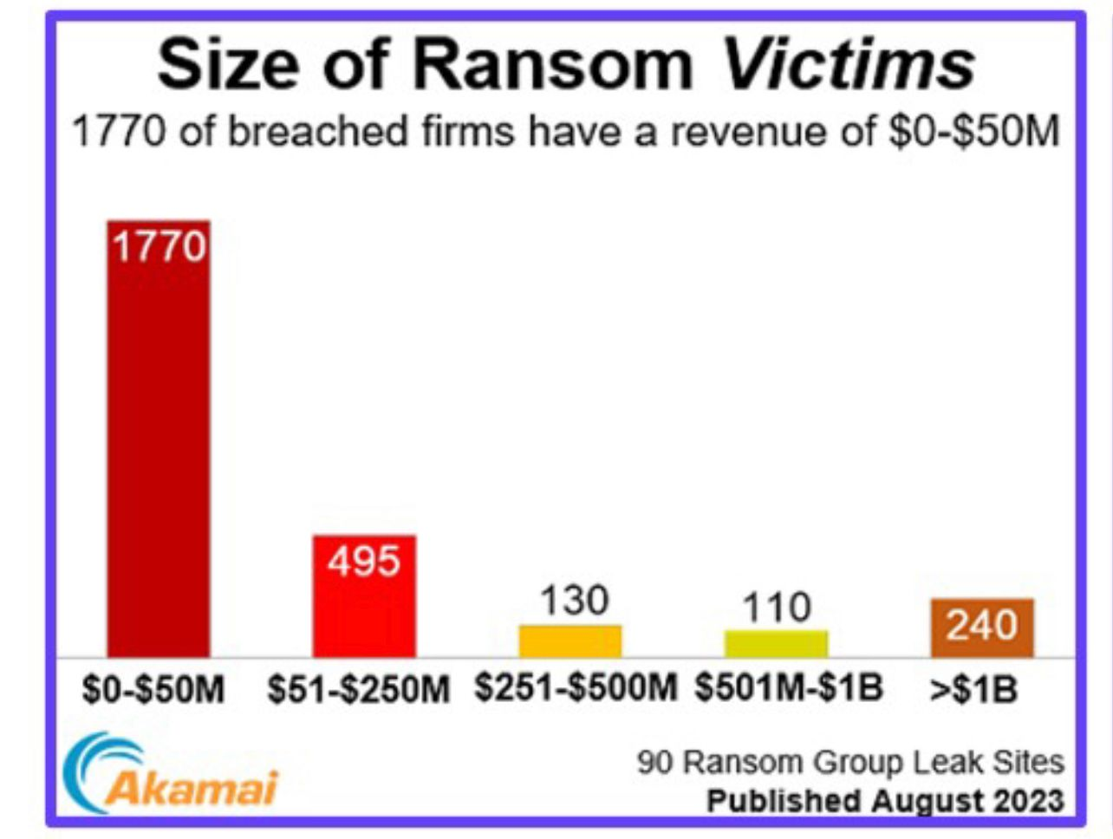

Slide 31
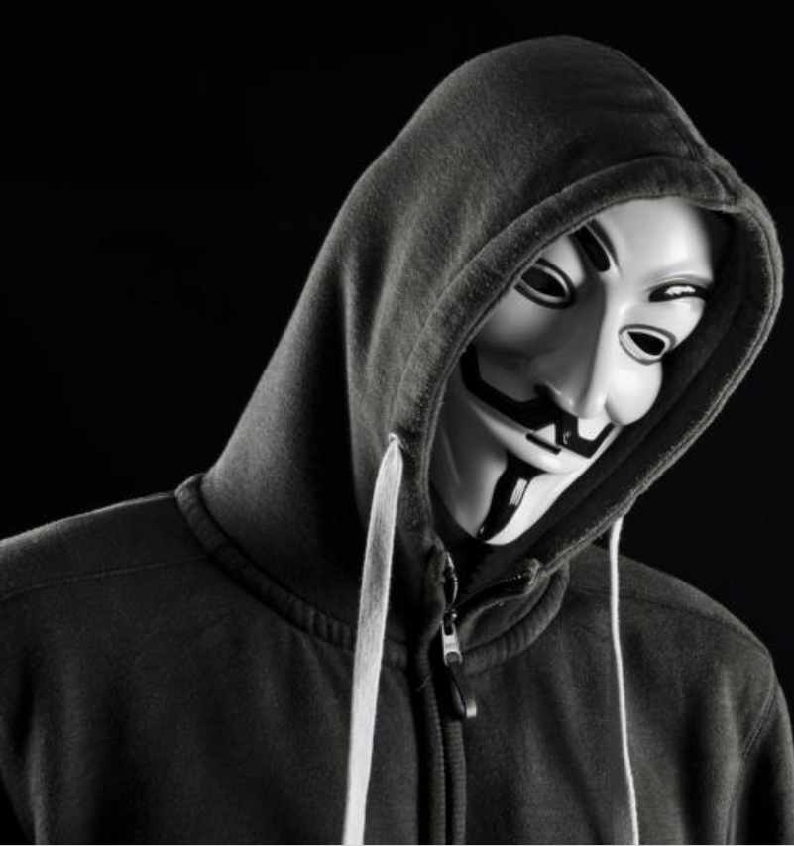
Two Real World Attacks
Notes:
Invitation

Slide 32
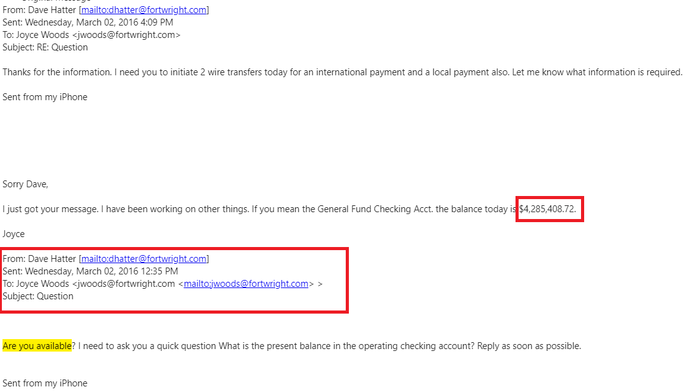

Slide 33
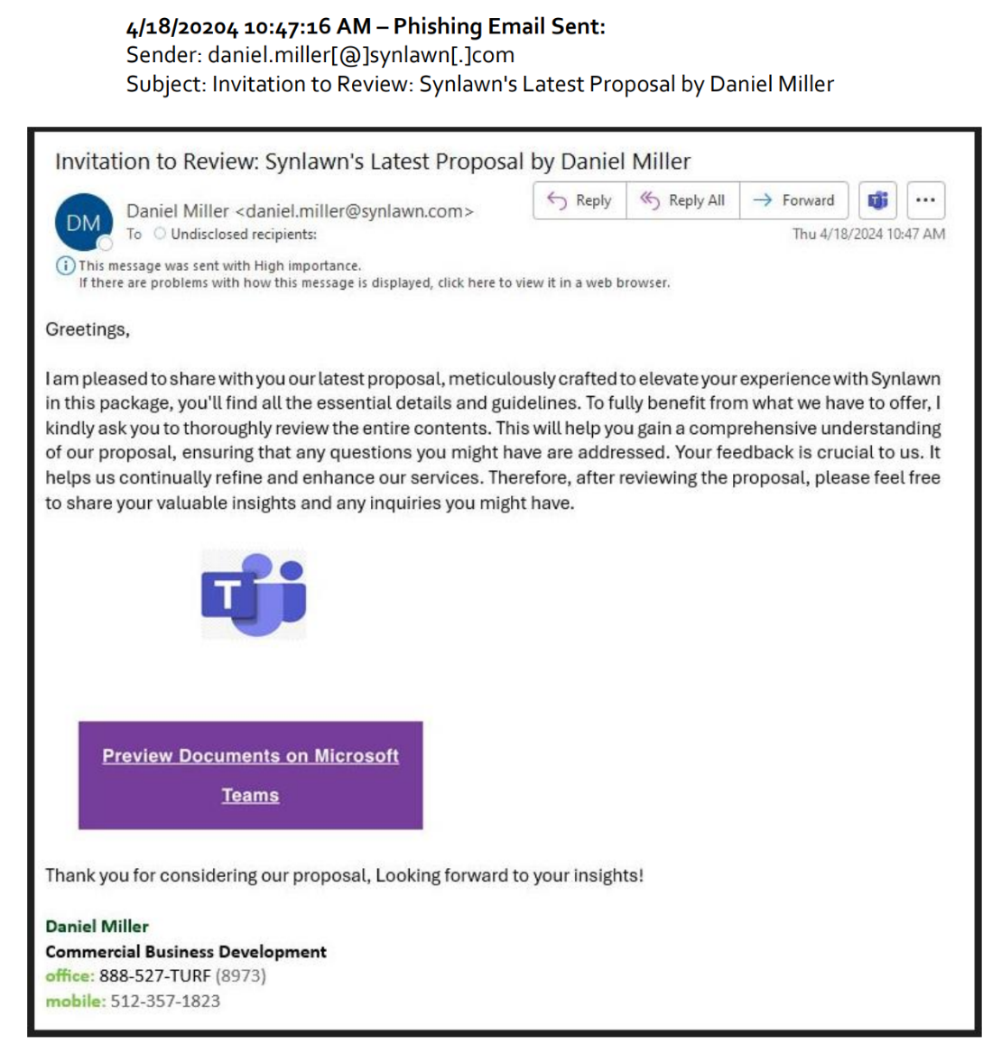
Account Takeover
10:47am:
Email received
10:49am:
User clicks link

Slide 34
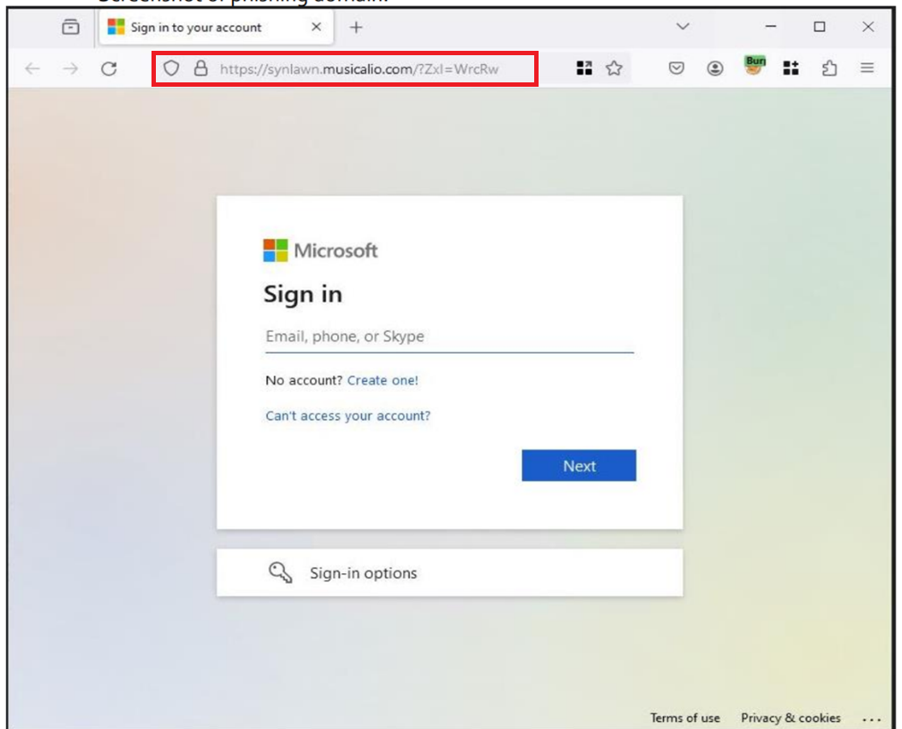
Account Takeover
10:50am:
User enters MS 365 credentials
10:50am:
Threat actor logs into account.

Slide 35
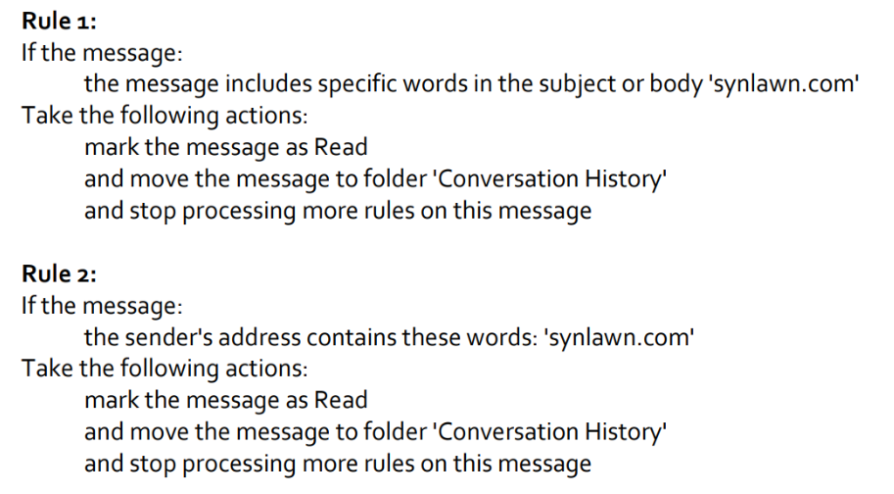
Account Takeover
10:52am:
Threat actor creates two inbox rules.
10:54am:
Alert generated, threat contained.

Slide 36
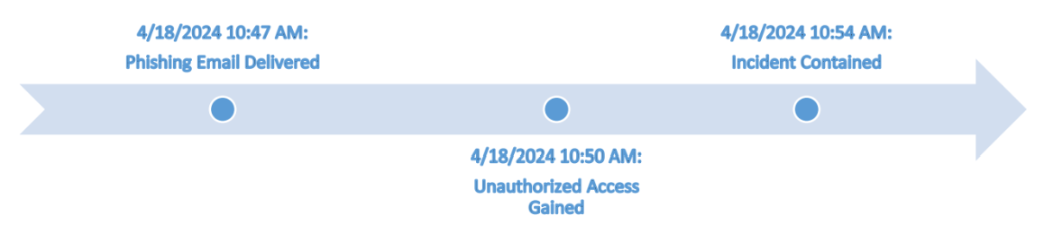
Account Takeover
3 minutes is all it takes…
Notes:
NEXT: DEFENSES

Slide 37
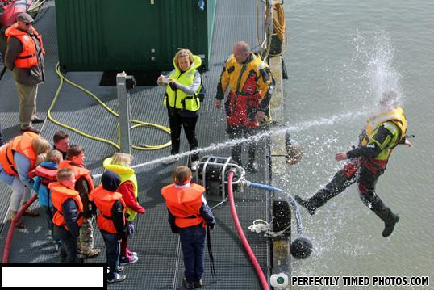
Hope and denial are NOT a strategy!
Don’t be scared be prepared!
Notes:
According to the 2018 Verizon Data Breach Investigations Report, 58% of cyberattack victims were small businesses (organizations with fewer than 250 employees). Many small and medium-sized businesses (SMBs) think that the data they have or have access to does not have value. Nothing could be further from the truth.

Slide 38
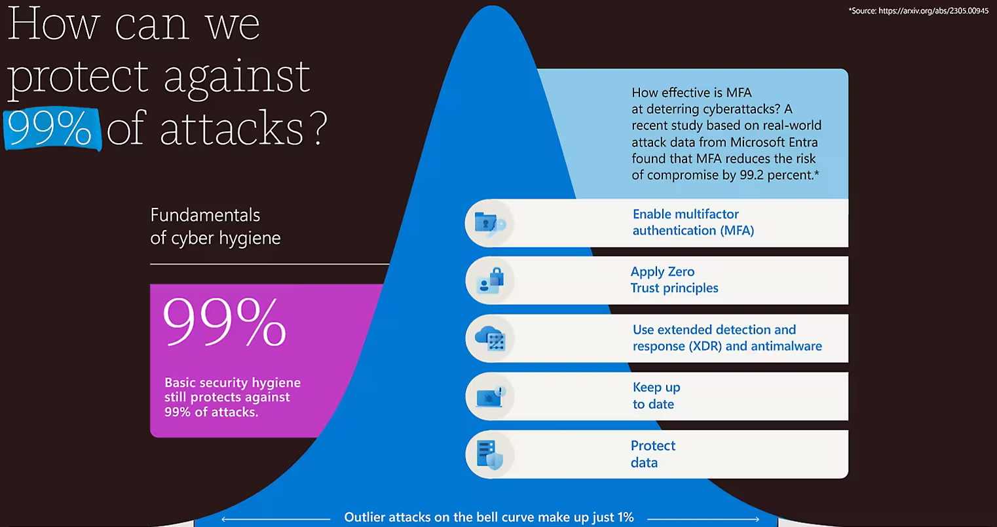
Notes:
Microsoft Digital Defense Report 2023
https://www.microsoft.com/en-us/security/security-insider/microsoft-digital-defense-report-2023#modal2

Slide 39
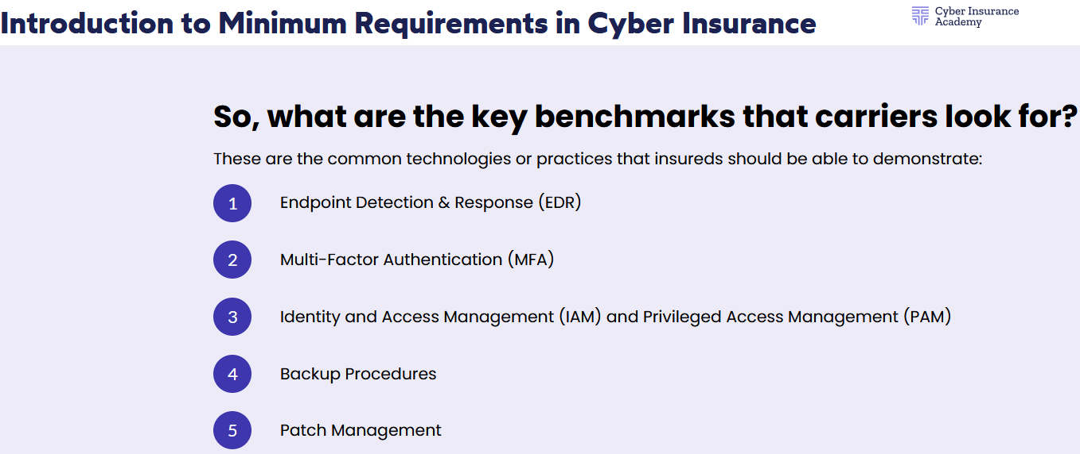

Slide 40

Defense in Depth
Notes:
2021 Verizon Data Breach Investigations Report
Data breaches make it worse

Slide 41
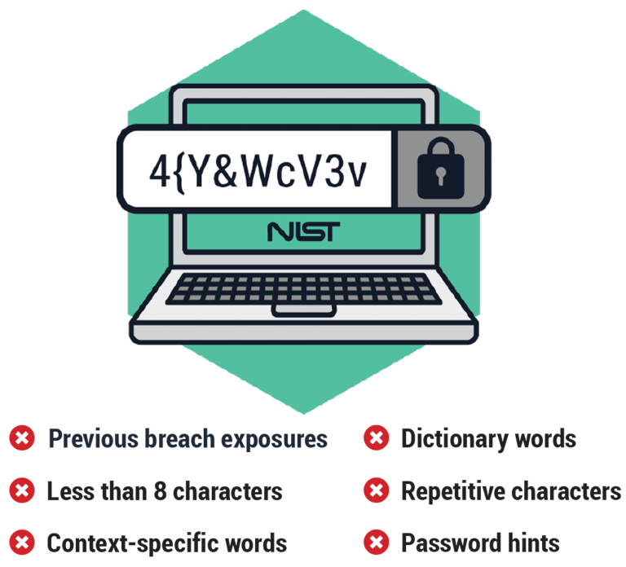
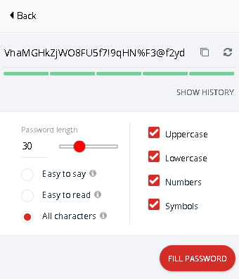
Password Hygiene
Use strong, unique passwords for every account
Passphrase is better: “1l0veP1zz@With0n10ns”
Use a password manager with MFA
Don’t use browser password manager
Notes:
A pass-phrase is a grouping of at least four random words - ideally with some capitalization, numbers, or symbols mixed in.
Some of the best include 1Password
Easy to Remember, Hard to Guess
https://spycloud.com/new-nist-guidelines/

Slide 42
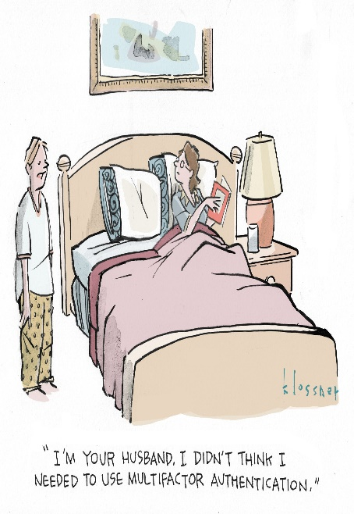
Multi-factor Authentication (MFA)
Aka Two-factor Authentication (2FA) or Two-Step Verification
Enable MFA everywhere
Common methods:
Text (SMS)
App
Hardware Key
Notes:
“Multi-factor Authentication (MFA) is the least you can do if you are at all serious about protecting your accounts. Use of anything beyond the password significantly increases the costs for attackers, which is why the rate of compromise of accounts using any type of MFA is less than 0.1% of the general population.” - Microsoft

Slide 43
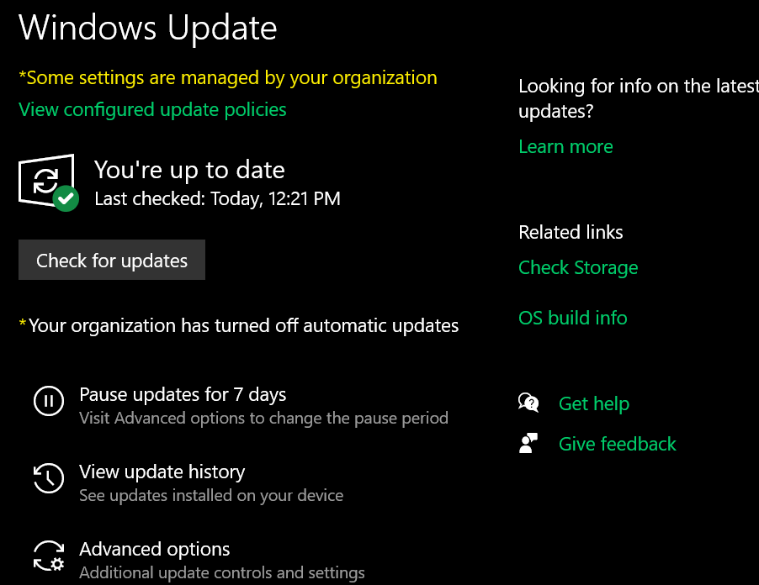
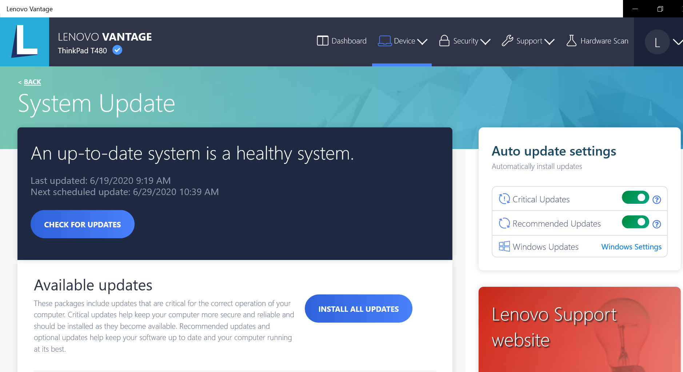
Patch Management / updates
ALL devices that contain software!
Prioritize around risk and severity
Automate
Notes:
Some insurance companies may require no more than 30 days.
Risk Based Vulnerability Management (RBVM)

Slide 44
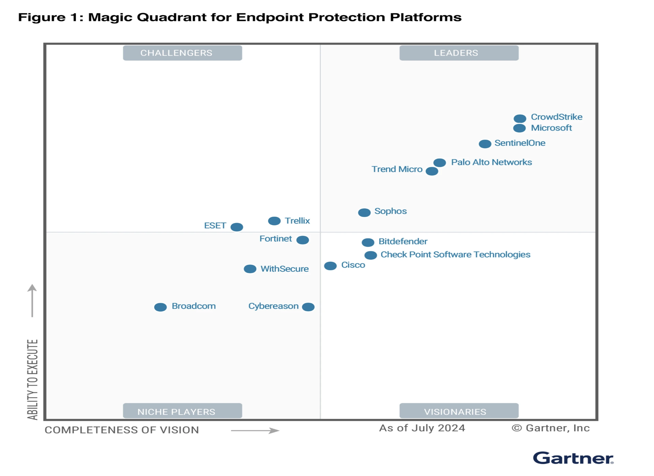
Endpoint Protection (EPP)
AKA:
Anti-malware
Anti-virus
MDR
EDR
XDR
Update!

Slide 45
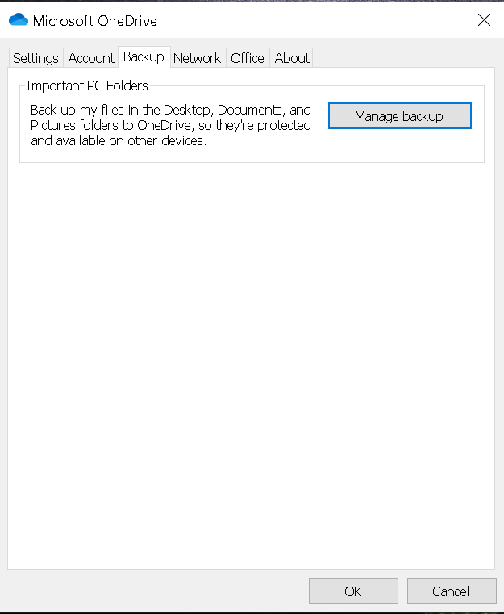
Backup / Resiliency
3-2-1 rule
At least 3 versions of data on two different media, one off-site
Test backups!
Notes:
Tested backups significantly reduce the cost an likelihood of paying a ransom
May reduce premiums by as much as 25%
Source: Global Insurance Market Report

Slide 46
Privacy != Security
Privacy: Control of your personal information and how it’s used
Why you close your curtains
Security: how your personal information is protected
Why you lock your doors
https://us.norton.com/internetsecurity-privacy-privacy-vs-security-whats-the-difference.html

Slide 47
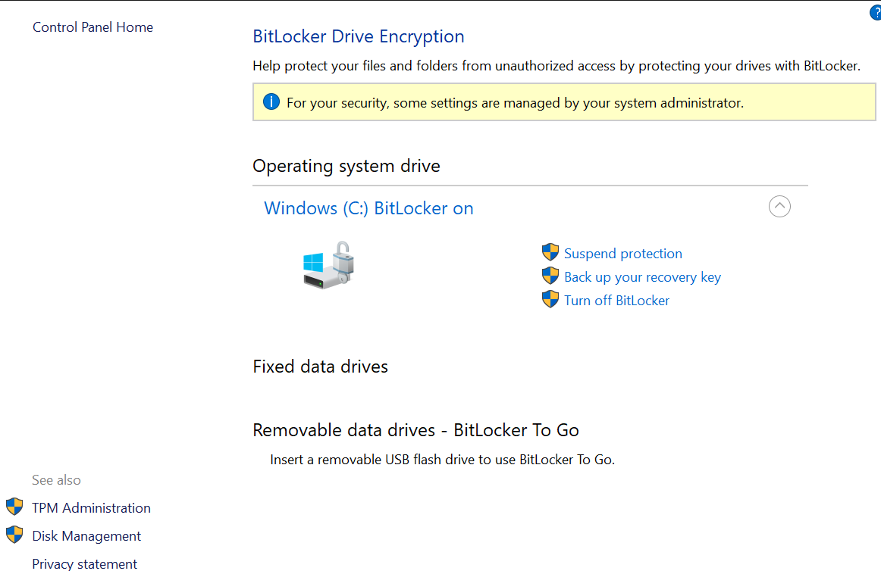
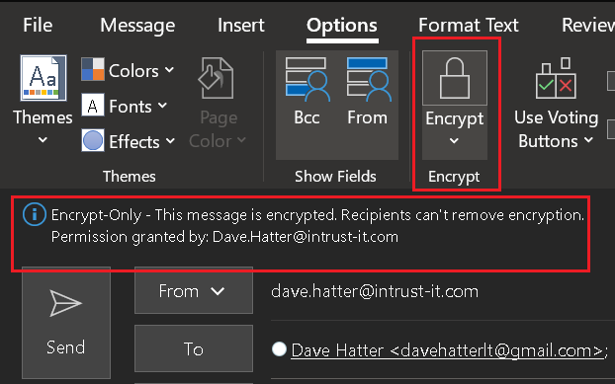
Encryption
Scrambles data so that it can only be unscrambled with the appropriate key
Encrypt data at rest and in transit
Notes:
E2E

Slide 48
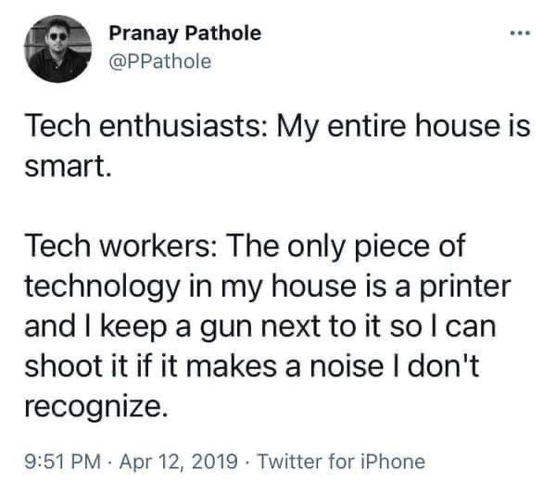
Internet of Insecure Things (IoT)

Slide 49

Public Wi-Fi
Information can be stolen
Malware can be planted
Use a VPN
Use a hotspot on your mobile phone
https://phoenixnap.com/blog/man-in-the-middle-attacks-prevention
Notes:
“We’re concerned that people are trading security for convenience…People are doing things on free Wi-Fi that are really alarming” ― Doug Shadel

Slide 50


Virtual Private Network
A VPN creates an encrypted connection
Less important if all your apps are cloud based
Never use public Wi-Fi without a VPN
Vet the VPN software carefully!

Slide 51
My Personal Tech Stack
Email: Proton mail
Browser: Brave, Firefox, Safari
Search Engine: DuckDuckGo, Brave, StartPage
DNS Resolver: Cloudflare
VPN: Proton VPN
Password Manager: 1Password
File sharing: Proton / MS OneDrive
MFA Authenticator: Authy / MS Authenticator
A/V: MS Defender
Firewall: MS Firewall
Encryption: BitLocker

Slide 52

Notes:
Summary

Slide 53

Notes:
“The methods that will most effectively minimize the ability of intruders to compromise information security are comprehensive user training and education. Enacting policies and procedures simply won't suffice. Even with oversight the policies and procedures may not be effective: my access to Motorola, Nokia, ATT, Sun depended upon the willingness of people to bypass policies and procedures that were in place for years before I compromised them successfully” ― Kevin Mitnick
NEXT: WRAP

Slide 54


Questions?
“Cybersecurity is national security”
- NSA Director General Paul Nakasone

Slide 55
Additional Resources
www.cisa.gov
www.fbi.gov
www.ic3.gov
www.cnet.com
www.zdnet.com
www.consumerreports.com
www.techradar.com
www.haveibeenpwned.com
foundation.mozilla.org/en/privacynotincluded
www.linkedin.com/pulse/media-appearances-dave-hatter-91fee/
www.linkedin.com/pulse/doomsday-daves-fun-scammers-page-dave-hatter-zrtce/
www.plunkfoundation.org

Slide 56
For more information
Bruce Schneier:@schneierblog
US-CERT: @USCERT_gov
SecurityWeek: @SecurityWeek
Center for Internet Security: @CISecurity
MSRC: @msftsecresponse
NIST Cyber: @NISTcyber
Intrust IT: @IntrustIT
CISA: CISAgov
MSRC: @msftsecresponse
Microsoft Secure: @msftsecurity
RSA: @RSAsecurity
Mikko Hypponen: @mikko
Troy Hunt: @troyhunt
CSOnline: @CSOonline
Me: @DaveHatter
Notes:
Reeses’

Slide 57

Thank You!
Dave Hatter, CISSP, CISA, CISM, CCSP, CSSLP, PMP, ITIL
linkedin.com/in/davehatter | x.com/davehatter
hh
Get our checklist: https://www.intrust-it.com/cyber-security/cyber-essentials-checklist
Ask ABOUT OUR no-cost, no-obligation ASSESSMENT
Catch Tech Friday live on 55KRC at 6:30 AM every Friday on 550 AM or http://55krc.iheart.com
Catch Cyber Monday live on WTVG at 6:30 AM and Tech Support at 9:00 AM every Monday on 13 ABC or https://www.13abc.com/

